Slide 1
Abstract Sculpture

Slide 2
What is Sculpture
What is sculpture? The word sculpture originates from the Latin word sculpere, which means "to carve". It can be defined as the art or practice of creating three-dimensional forms or figures.
Sculptures can be free-standing or "in the round" (able to be viewed from all sides) or they can be in relief (form is carved or modeled from a flat background plane).
They can be made of almost any organic or inorganic substance. Common materials include bronze, plaster, clay, wood, papier maché, and plastic.
The processes involved in creating sculptures date back to antiquity and, until the twentieth-century, have changed very little. However, the twentieth-century has brought new ideas, techniques, and materials to the art of sculpture, making them even more common to encounter in our everyday lives.

Slide 3
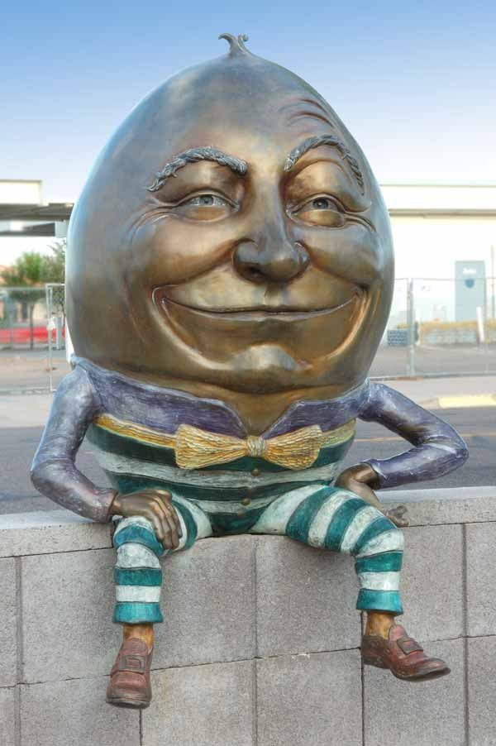
Sculpture in the round

Slide 4
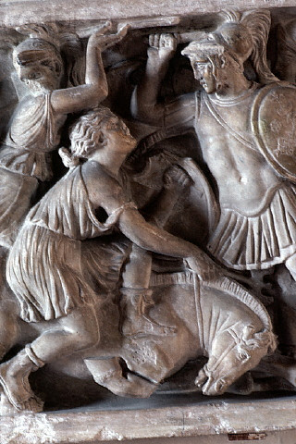
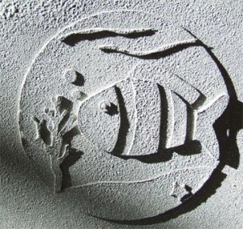
Sculpture - Relief
low
high

Slide 5
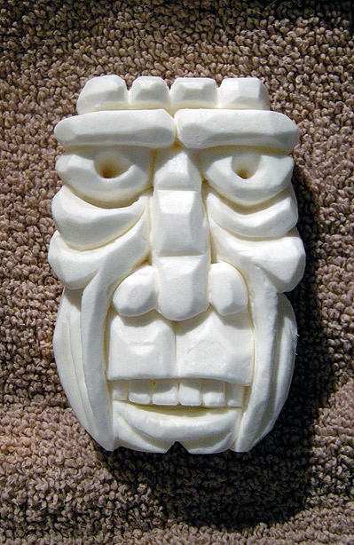
Soap

Slide 6
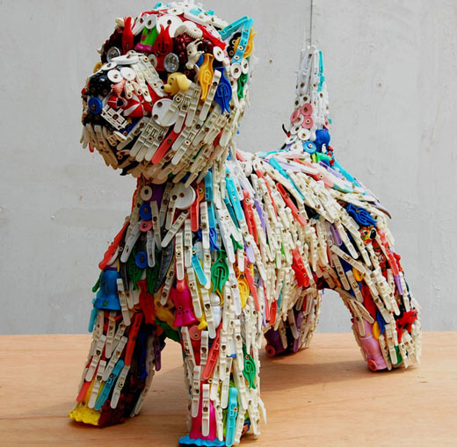
Plastic

Slide 7
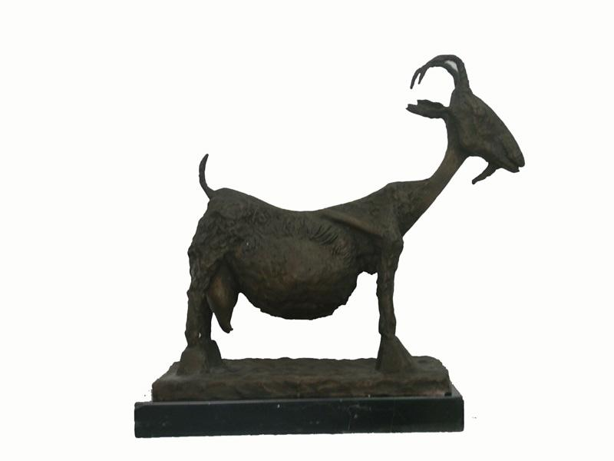
Bronze

Slide 8
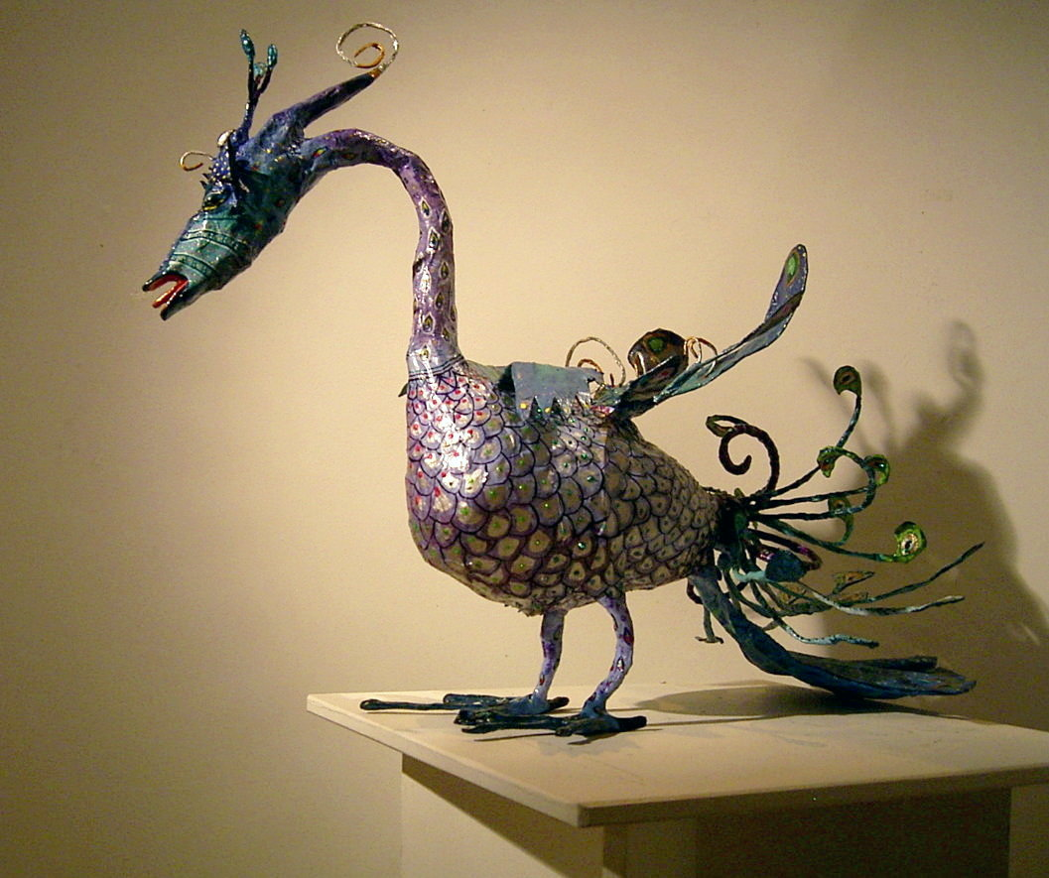
Papier mache

Slide 9
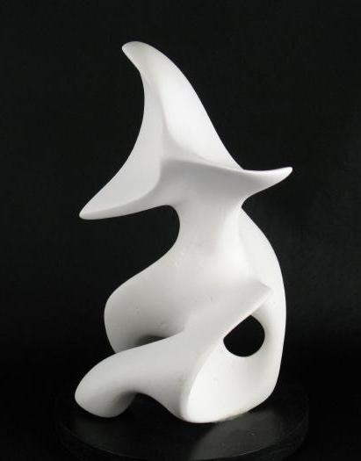
Plaster

Slide 10
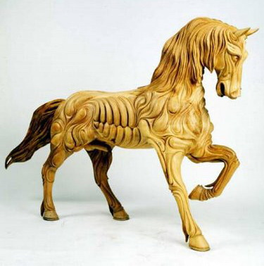
Wood

Slide 11
Method - Carving
Dating from pre-historic times, carving is a process in which the artist subtracts or cuts away from a solid material to reach the desired form.
It can be a very painstaking and time consuming method because of the hard and weighty materials, such as marble or other stones, that are often used.
Artists can also carve softer substances such as wood and even soap.

Slide 12
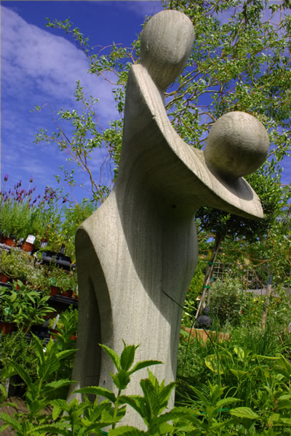

Slide 13
Modeling
Modeling is the process of manipulating soft materials to create a three-dimensional form. Unlike carving, modeling requires soft substances that can be easily and rapidly shaped by the sculptor's hands.
Clay is the most frequent material used for modeling, however, others such as plaster, papier-maché, and wax are also common

Slide 14
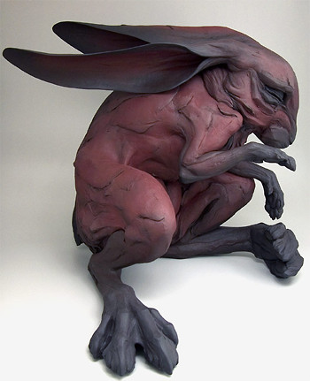

Slide 15
Casting
Casting is a method of obtaining the permanence of a modeled work by making a mold and casting it in a durable material such as bronze.
Two methods of casting are used: sand casting and the cire-perdue or "lost wax" process.
The lost-wax process is more widely used, however, both have been frequently employed since antiquity.

Slide 16
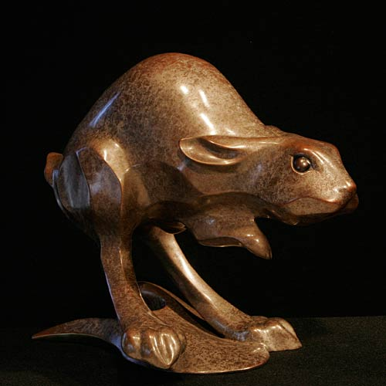

Slide 17
Construction and Assemblage
Emerging in the twentieth-century, the techniques of assemblage and construction consist of combining and joining various materials to form a three-dimensional object.
These methods originated from the technique collage, which was popularized by the Cubists during the early part of the twentieth century.

Slide 18
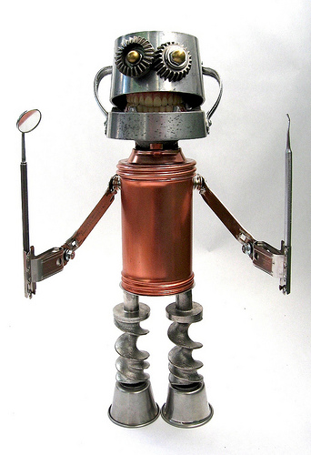

Slide 19
Abstract: Movement
Working in clay, we are going to create a small sculpture.
Sculpture may be of a human or animal.
Project planning – form, notes, rough sketch.
Sculpture must be “in the round”.
Theme is movement.

Slide 20
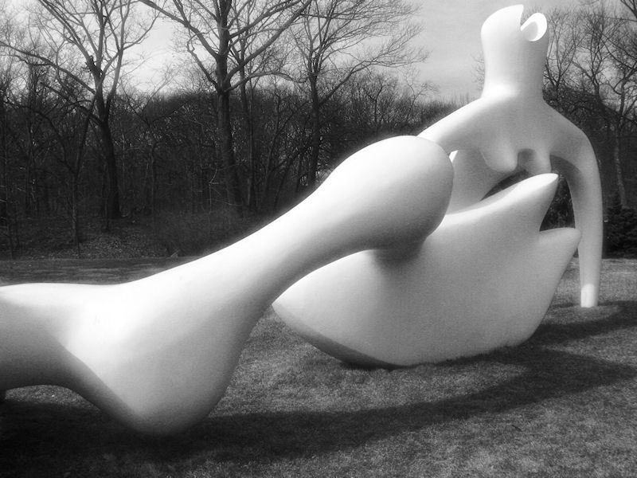

Slide 21
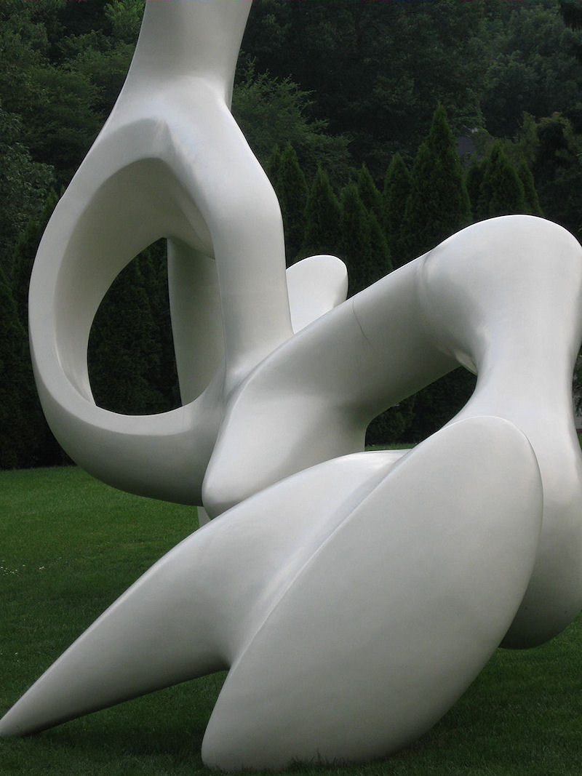

Slide 22
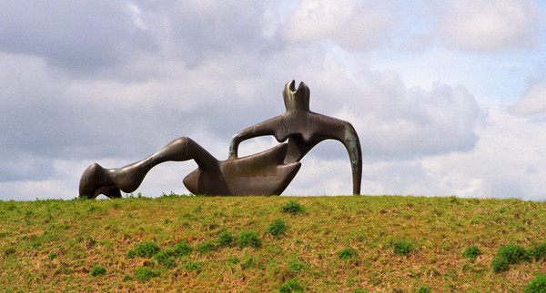

Slide 23
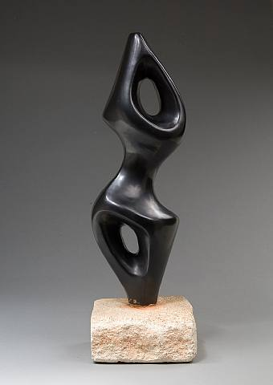

Slide 24
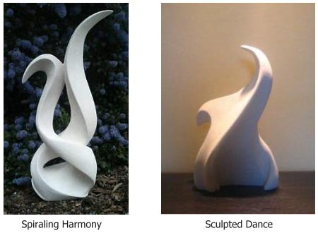

Slide 25
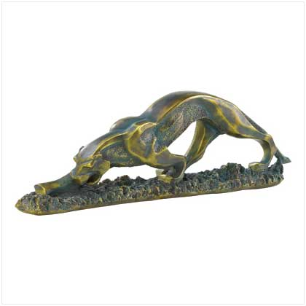

Slide 26
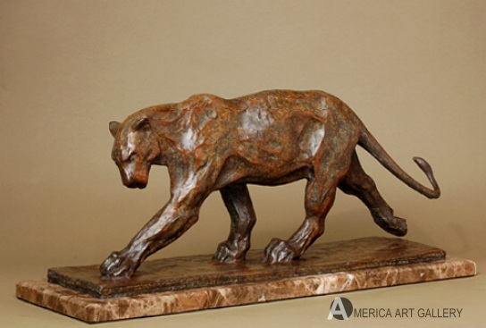

Slide 27
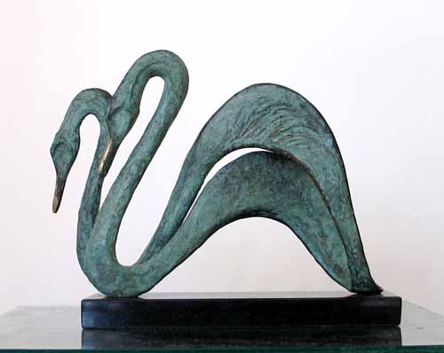

Slide 28
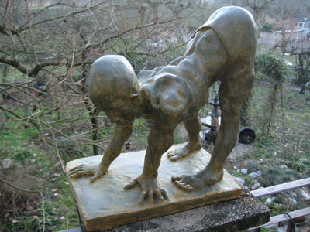

Slide 29
