Slide 1
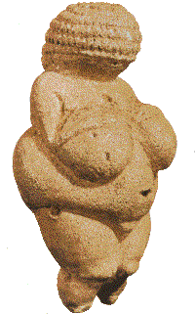
Brief History of clay
Prehistoric origins

Slide 2
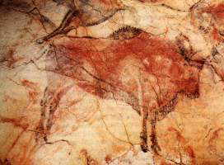
Stone Age
Despite their primitive lifestyle, stone age people made many realistic and lively images, mostly drawn, scratched or carved on bare rock walls.
Probably the most sophisticated and life-like Old Stone Age paintings of animals are found in the Caves of Lascaux in France.

Slide 3
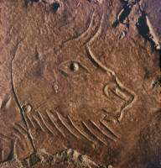
Earliest Clay Art
Although more fragile than cave paintings, some clay images of animals have survived.
This image of a bison head was
discovered in a cave in the foothills of
the Pyrenees in France. The image was
created by scratching in clay that had
been smeared on the cave wall.

Slide 4
Humans in Clay
Besides painting and creating animal images, early people also carved small human figures in stone, bone or clay.
Figures were often abstracted
images of women and are believed
to be mother-goddess or fertility
images. The most famous is the
20,000 year old limestone carving -
Venus of Willendorf.

Slide 5
Ceramic Discovery
The discovery that fire turned soft crumbly clay into permanent shapes was the beginning of ceramics.
This discovery most likely occurred around 27,000 years ago (according to recent scientific testing done on some Stone Age figurines found in prehistoric sites)

Slide 6
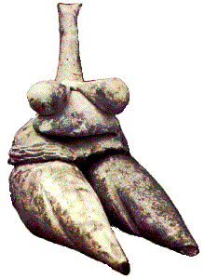
Hunter to Farmer
As the ice age came to an end, and early people began settling on permanent sites, clay use increased.
New Stone Age people still carved small figurines.
This figurine was discovered in the prehistoric village of Tepe Sarab in western Iran.

Slide 7
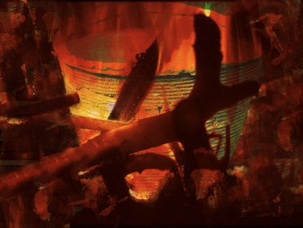
New Containers!
Skulls, nuts, shells and fruit skins were the main liquid holding vessels by prehistoric people.
The discovery that small amounts of clay could be squeezed and pressed into cups and bowls a put in a bonfire to make them permanent
was the birth of
modern
day ceramics.

Slide 8
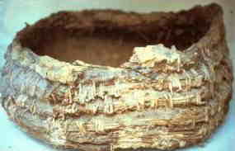
The Basket and the Pot
Basket weaving is certainly older than pottery. The influence of woven patterns on early pottery is quite considerable.
In some of these early communities, basket making probably led to the technique of pottery making.
This is the remains of an
ancient basket found in
the mud of the river Nile, Egypt.
This basket was made with a
variety of plant stalks. When
lined with animal skin or fat these
basket could hold water.

Slide 9
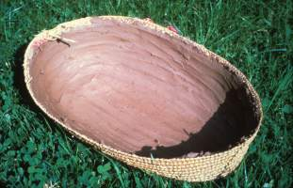
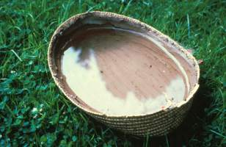
Better Way
At some point someone discovered an eaiser way to make plant based baskets efficient at holding water – CLAY.
Smearing clay on the inside of a basket it seals to pores and makes holding water more efficient.

Slide 10
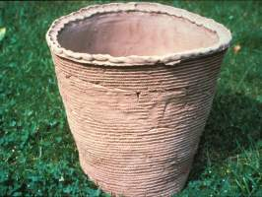
FIRE
Fire is a hazard in an community, and at some point a fire must have broke out and been hot enough to bake some of these clay lined baskets, leaving just the clay portion.
The result of this would be a clay pot, which unlike a basket would be rot proof and rat proof and therefore a very valuable vessel.

