Slide 1
Coil Building
Ceramics

Slide 2
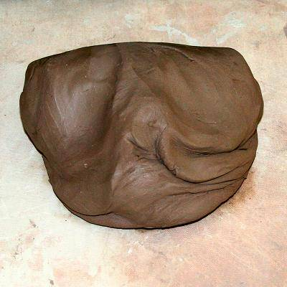
Wedge Clay
WEDGE YOUR CLAY – this will homogenize the clay and get any air bubbles out of the clay.

Slide 3
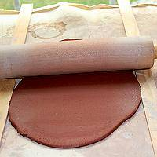
Make Slab
Make a base using the slab method. Base should be about the thickness of your pinky finger.

Slide 4
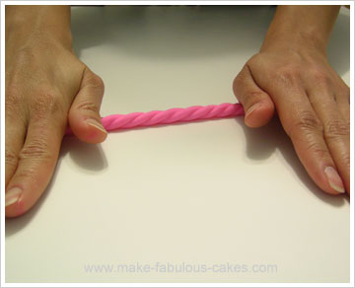
Coil
Make coils. Coils should be rolled out so that they are even and round. A good method is to roll using the entire palm of your hand from bottom to top.

Slide 5
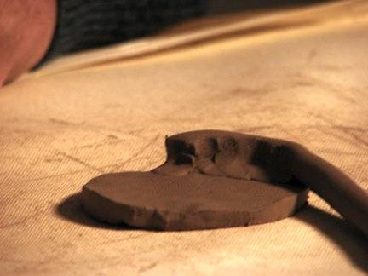
Add coil to slab bottom
Begin placing your coil on the top part of the bottom slab – not the sides. Doing it this way results in a much stronger joint. Make sure to score and slip the surfaces being stuck together. Once the first coil is in place you can cut off the excess slab.

Slide 6
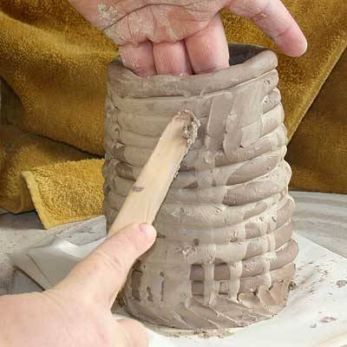
Add coil to coil to coil…
The strongest joints are welded on both the interior and exterior of the wall.
Welding is simply using your thumb on the inside surface moving downward, and your fingers on the outer surface moving upward.
Welding will thin the walls and expand them outward. Take coil thickness into consideration when coil building. Coils need to be thicker than the final wall will be.

Slide 7
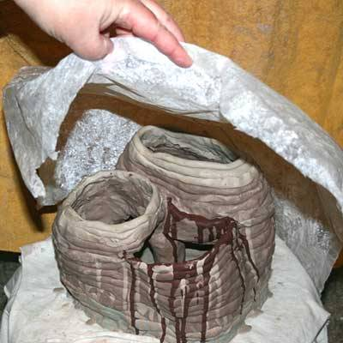
Moving Inward
The natural inclination of the clay is to expand and move outward. To move the wall inward, coils need to be applied to the inner portion of the uppermost row.
Another way to move inward would be to reverse your welding technique.
Coils can be time consuming – cover your projects between working on them.

Slide 8
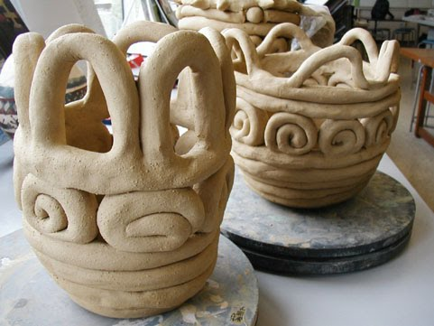
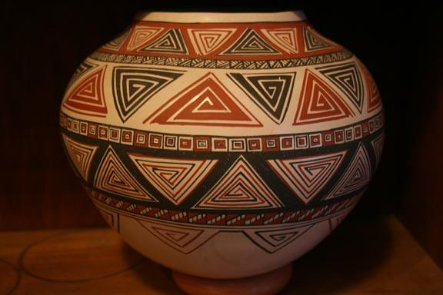
Examples of Coil Ceramics

