Slide 1
MAKING COMICS
Making comics
Sketchbook # 6

Slide 2
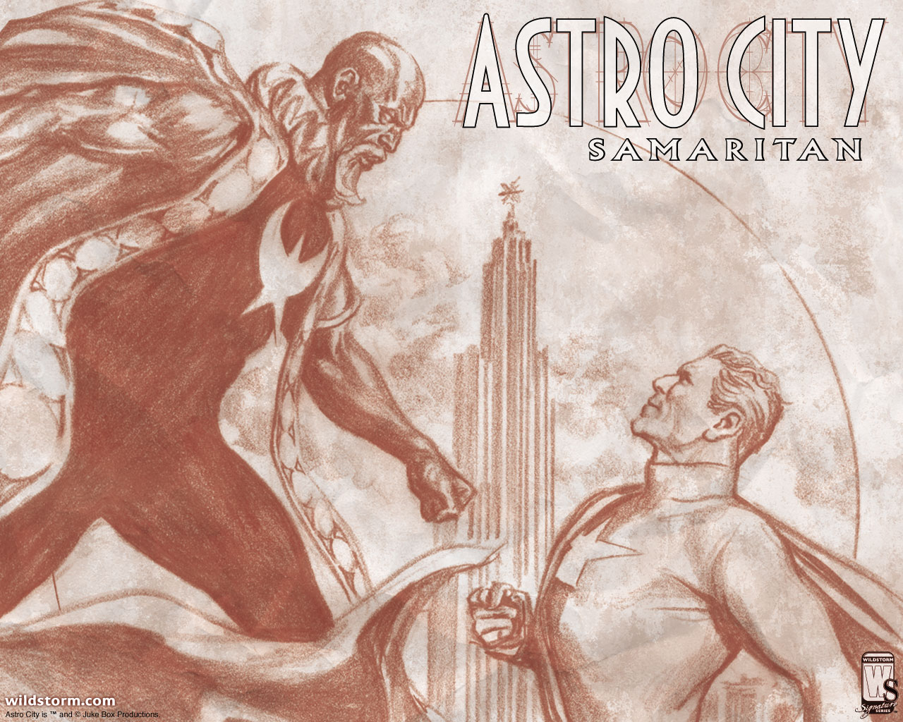
What
is a
comic?

Slide 4
Comics:
A graphic medium in which images convey a sequential narrative….so basically pictures in a sequence that tell a story.

Slide 5
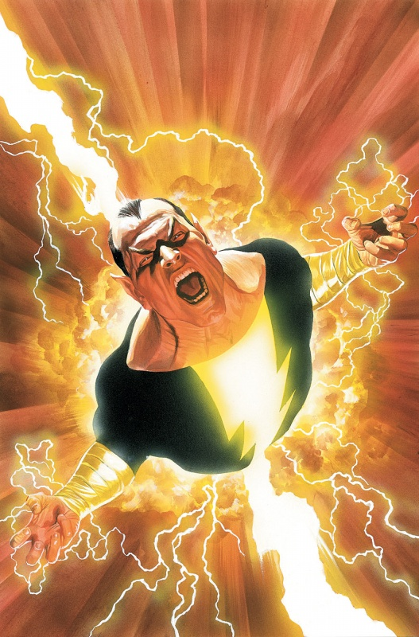
Five important things to keep in mind when making comics:
Choice of Moment
Choice of Frame
Choice of Image
Choice of Words
Choice of Flow

Slide 6
Choice of Moment
What to include and what to leave out.
Each panel furthers the plot
Consider what you want from each part of your story.
Transitions from panel to panel.

Slide 7
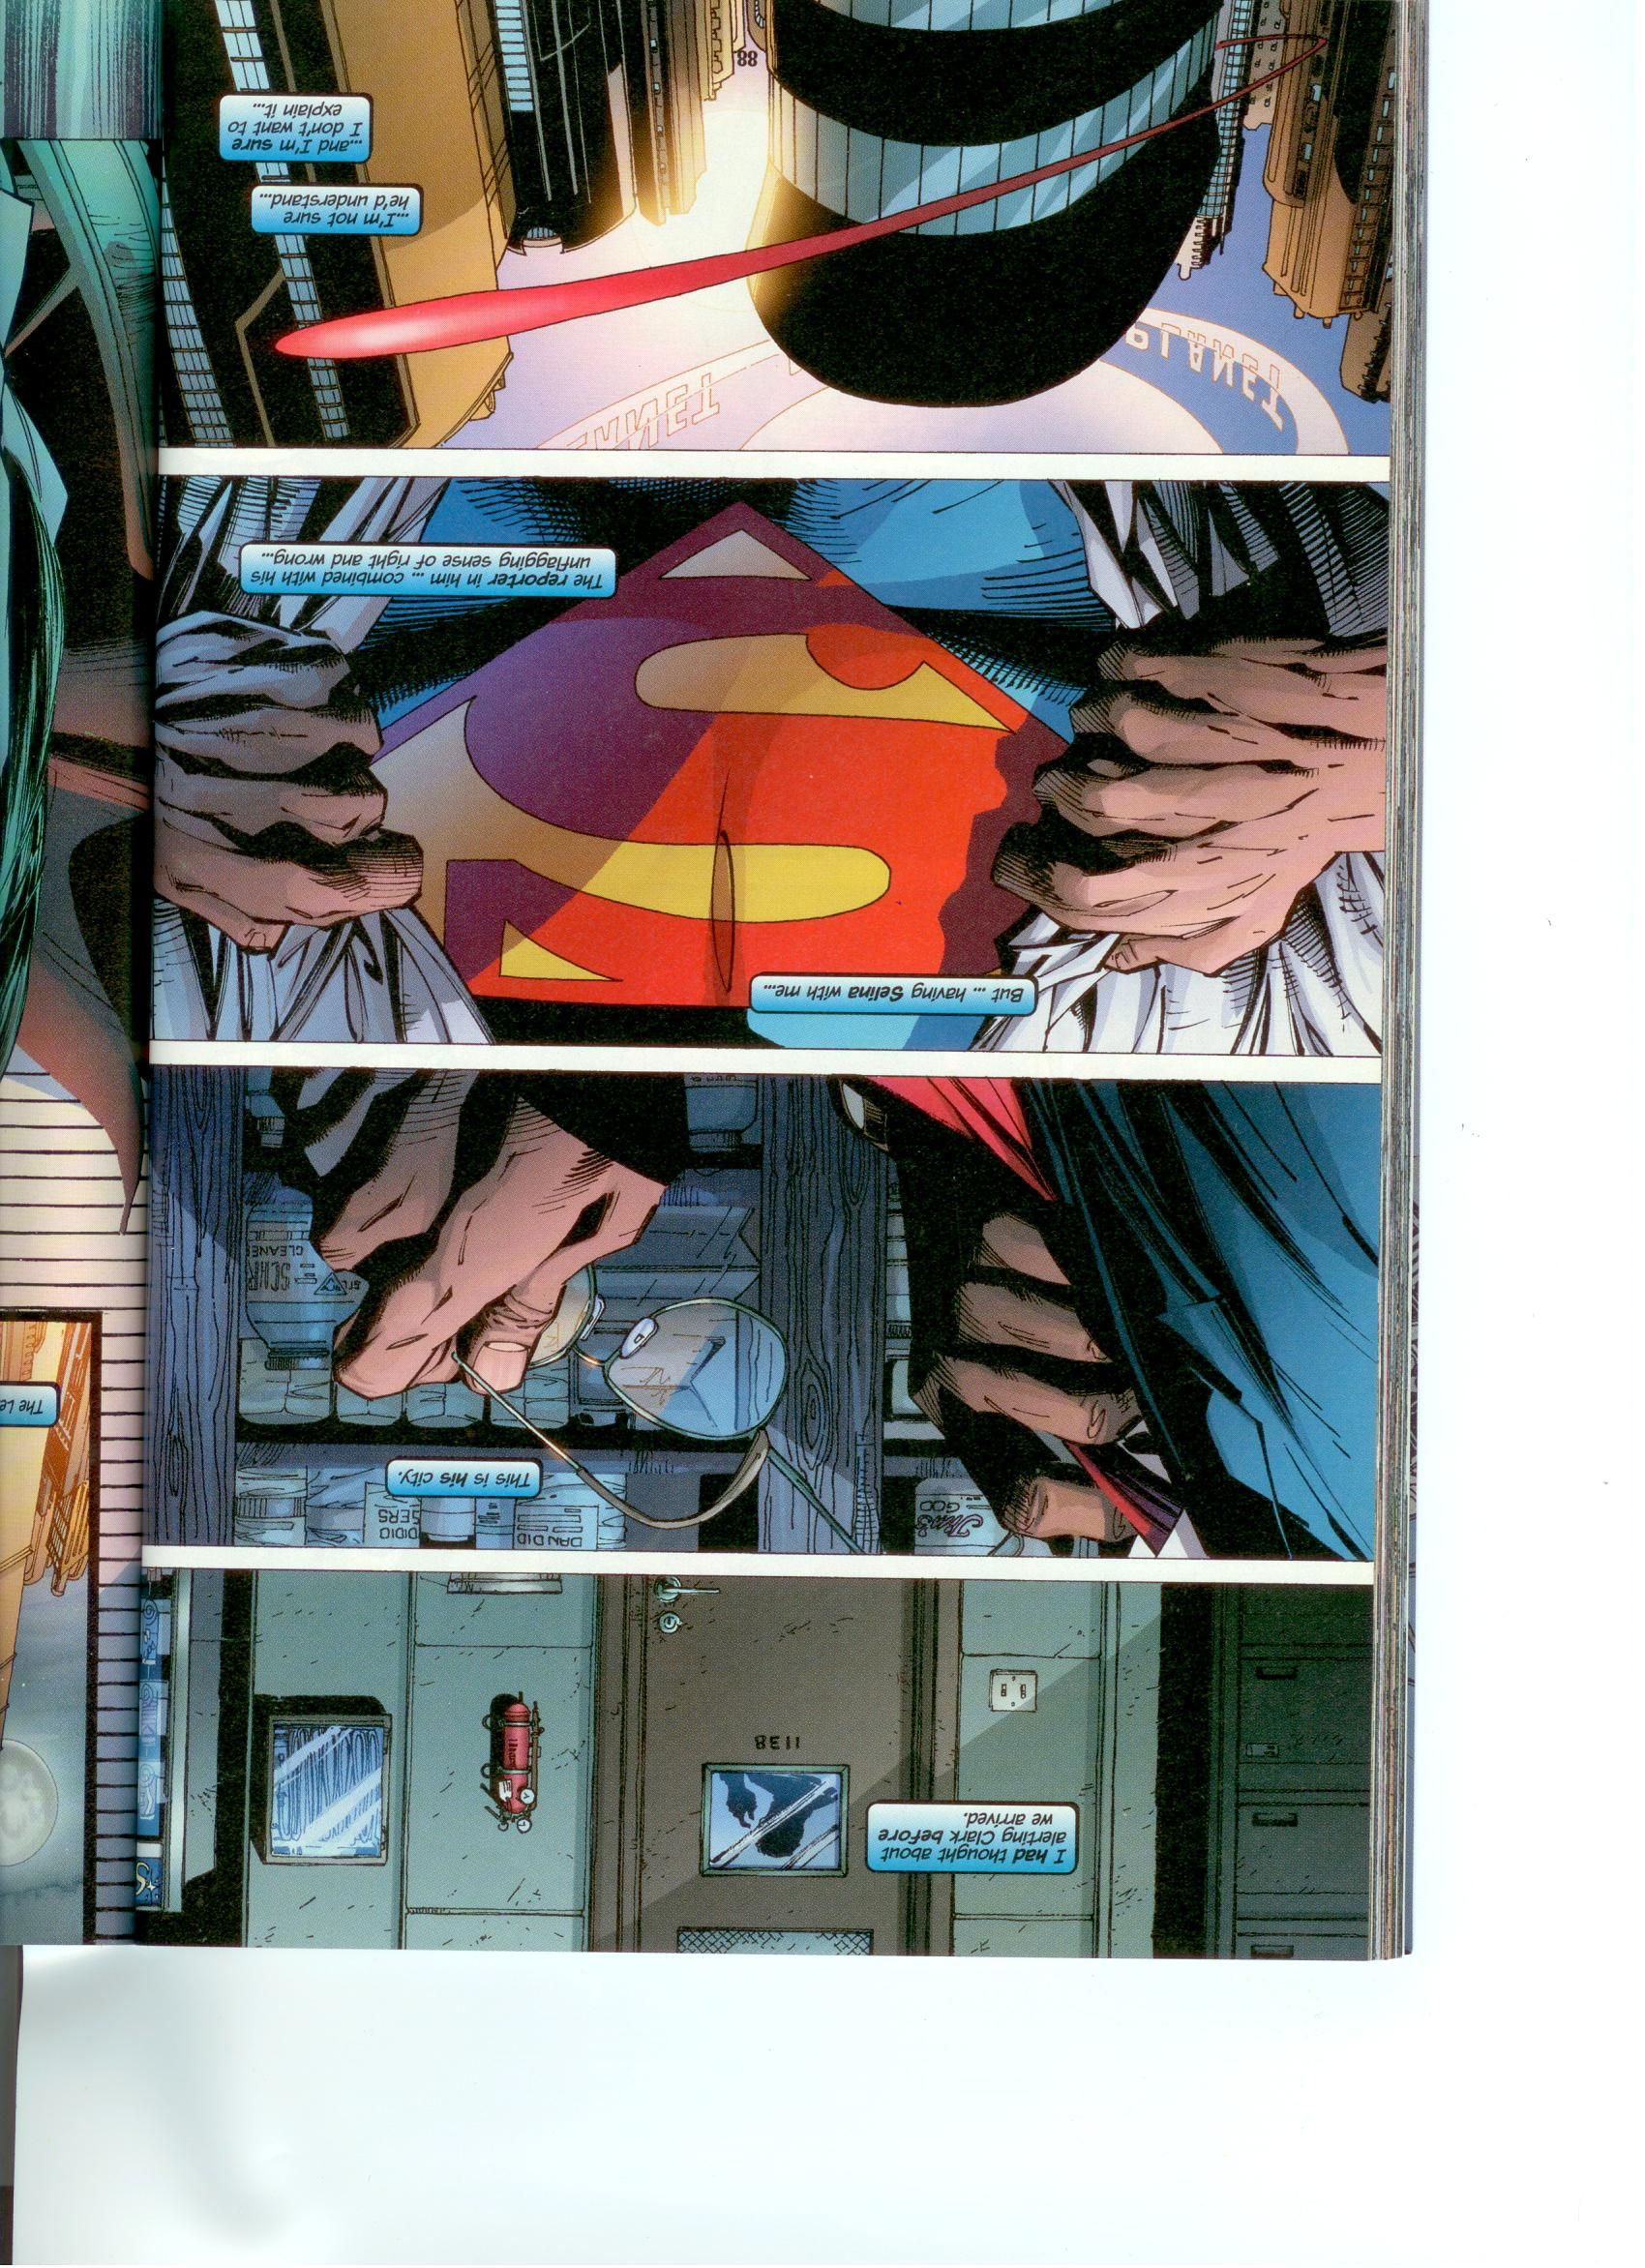
With this panel left out – what is the story about?

Slide 9
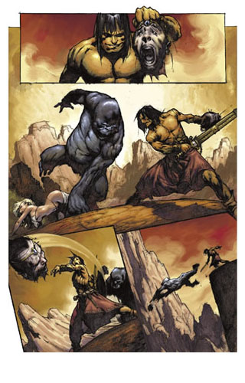
Choice of frame:
Show readers what they need to see.
Establish a sense of place, position and focus.
Like choosing a camera angle in photography

Slide 10
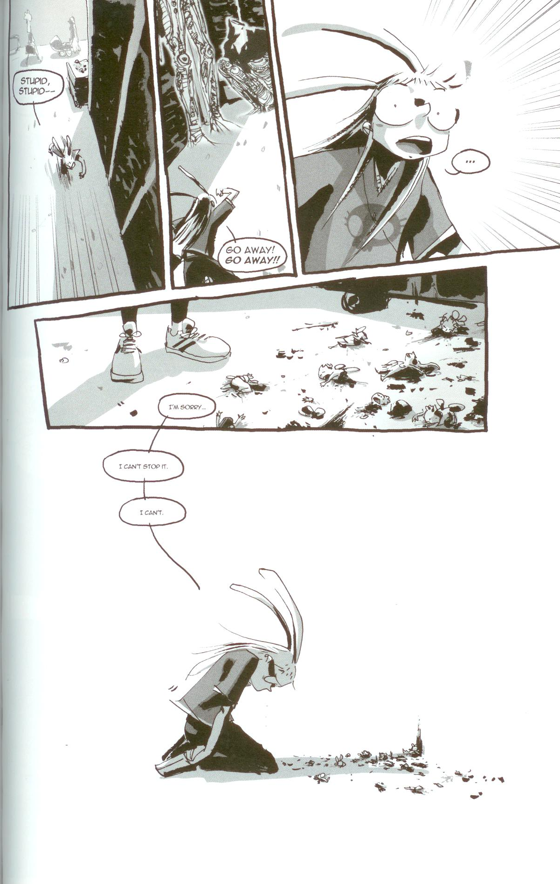

Slide 11
Choice of Image:
Bring your story to life visually
Communicate QUICKLY, CLEARLY and COMPLELLINGLY
Be Specific - include real life detail – even if working with stick figures.

Slide 15
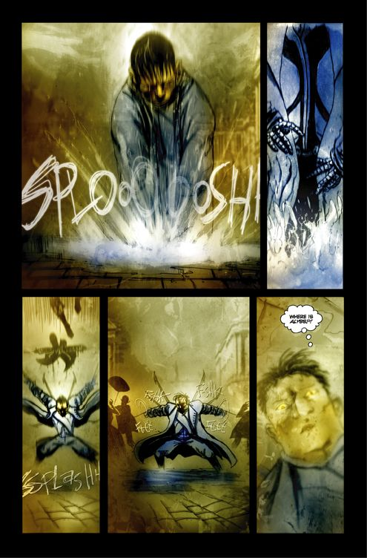
Choice of words
Powerful way to communicate.
Must work with images seamlessly.
There is no image so vague that words can’t lock in a desired meaning.
Know when you image is powerful enough to leave the words out.

Slide 18
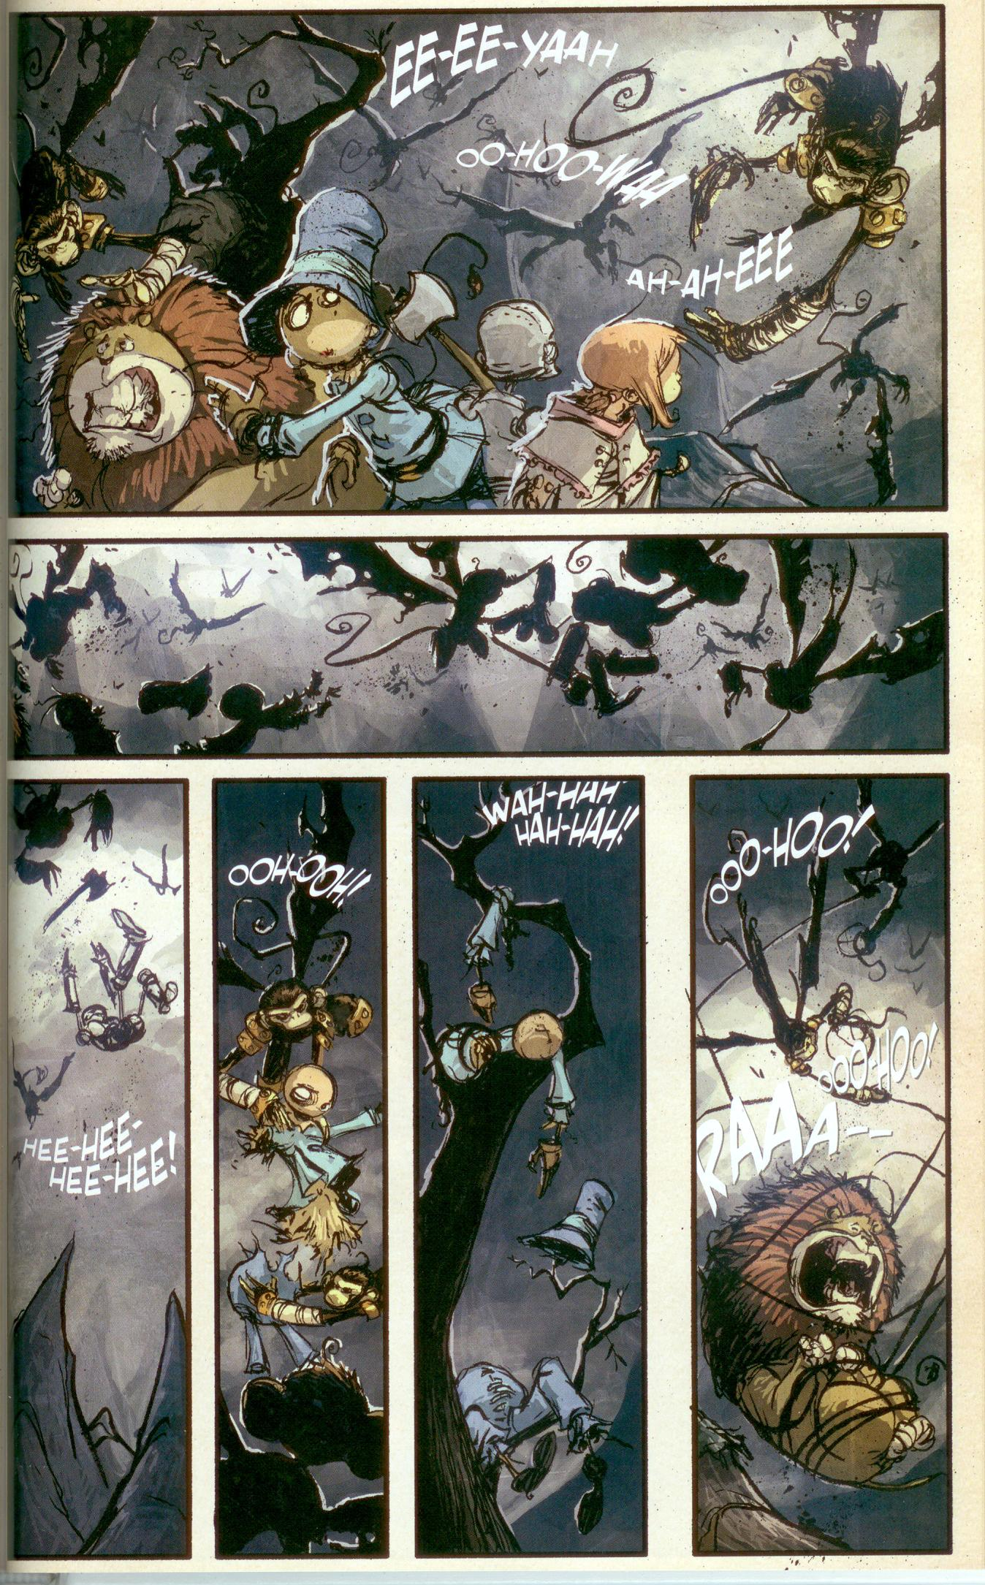

Slide 19
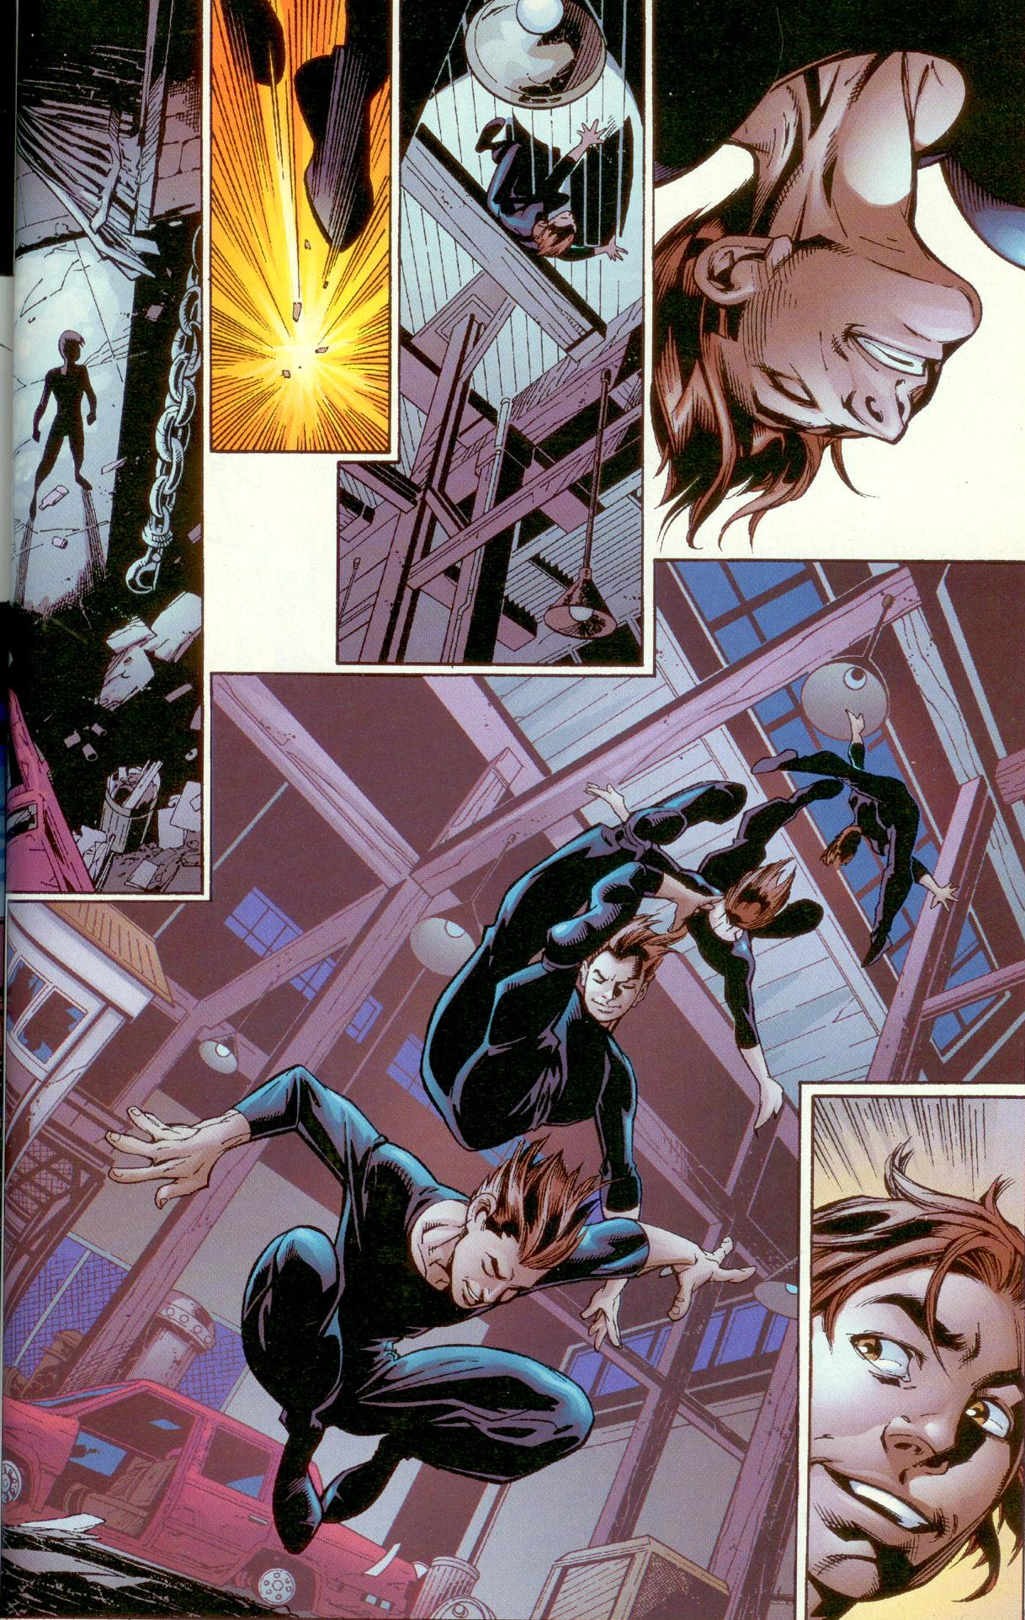
Choice of flow
How you guide your readers through your work
Readers read
left-to-right
and
up-to-down
K.I.S.S
Not all pictures are created equal – remember focal points.

Slide 20
Assignment
Create a comic from wise saying on the card given you. Your comic must be a minimum of 3 frames, include words and images.
Be creative!
Have fun!

