Slide 1
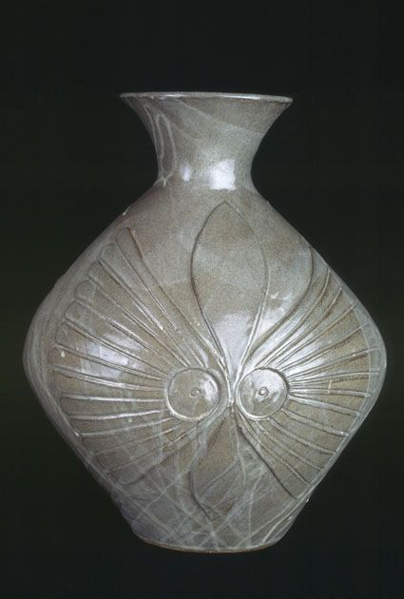
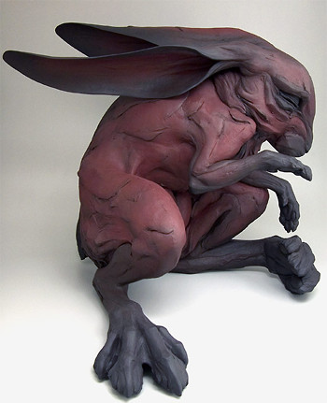
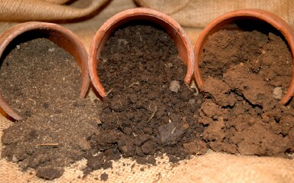
Clay
Ceramic and Sculpture

Slide 2
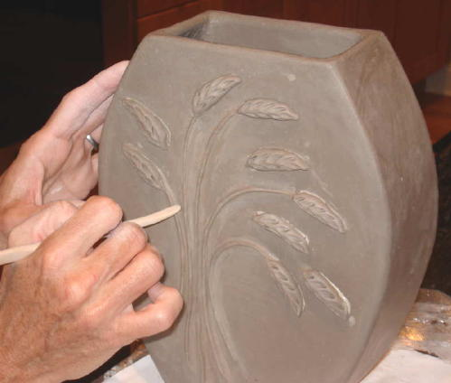
Handbuilding
This term refers to the one of several techniques of building pots using only the hands and simple tools rather than the potters wheel. The term for creating pottery using the potters wheel is “throwing”.

Slide 3
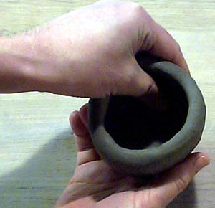
Pinch
“Pinch” in ceramics is a method of shaping clay by inserting the thumb of one hand into the clay and lightly pinching with the thumb and fingers while slowly rotating the ball in the pal of the other hand.

Slide 4
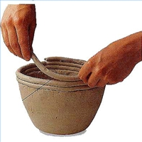
Coil
This is the technique of building ceramic forms by rolling out coils, or ropes, of clay and joining them together with the fingers or a tool.

Slide 5
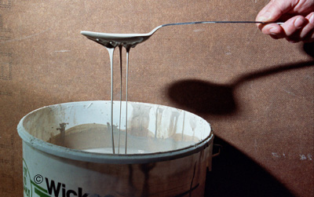
Slip
Slip is liquid clay. It is created by adding clay to water. Slip should be the consistency of thick cream.

Slide 6
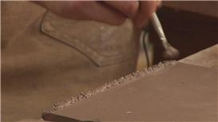
Score and Slip
Score and slip refers to the method used to join two pieces of clay together. First you must score the surfaces of the clay to be joined. This simply means scratching the surface with a tool of some sort. After scoring the clay, you add slip (small amounts). An effective easy way to score and slip in one action is to score with a wet toothbrush, the toothbrush will score the surface, and the water from the toothbrush creates slip on the scored surface. Next, you press the two pieces together.

Slide 7
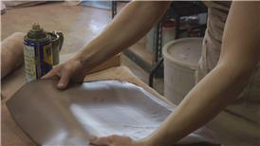
Molding
Flat slabs of clay are pressed into molds in order to create various shapes and forms.

Slide 8
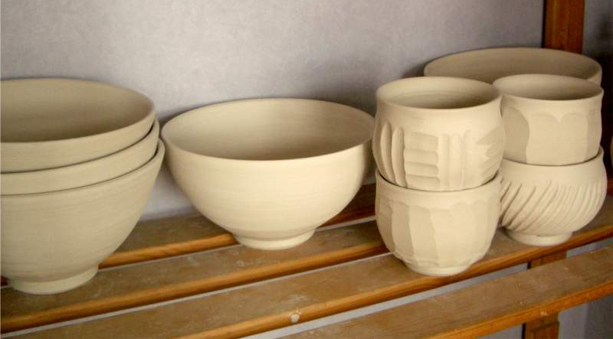
Greenware
Ceramic ware that not yet been fired. Greenware must be completely dry in order to be fired. If the ceramic ware is bone dry, and still feels cool to the touch, it is not dry yet.

Slide 9
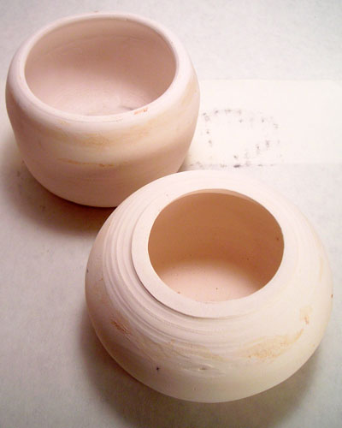
Bisque
Ceramic ware that has been fired once without glaze.

Slide 10
Glaze
A glass-like surface coating for ceramics that is used to decorate as well as seal the pores of the fired clay.

