Slide 1
TYPE
As Art
Sketchbook # 7
Free Powerpoint Templates

Slide 2
Type is a crucial element of any design in which it appears – and is used most in graphich design.
Type is percieved by the viewer in several ways simultaneously:
Free Powerpoint Templates

Slide 3
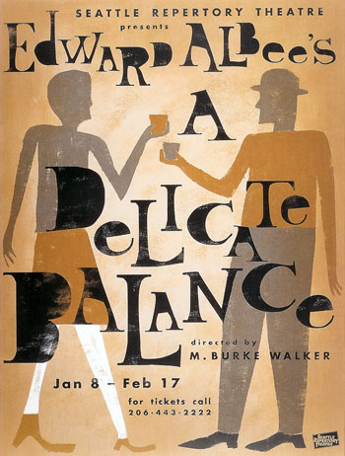
As text to read:
Free Powerpoint Templates

Slide 4
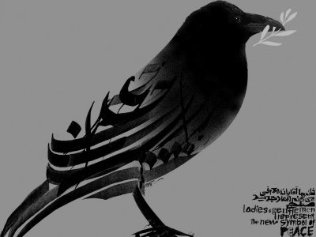
As shape:
Free Powerpoint Templates

Slide 5
VISUAL
Purely
element – where letterforms themselves convey a
FEELING or MEANING
Free Powerpoint Templates

Slide 6
movie time
Free Powerpoint Templates

Slide 7
Types of font:
Serif
San Serif
Display
Script
Free Powerpoint Templates

Slide 8
Choice of typeface depends on the context of the text.
peace
war
peace
war
peace
war
Free Powerpoint Templates

Slide 9
Type is everywhere!
Look around the room – find examples of type.
Free Powerpoint Templates

Slide 10
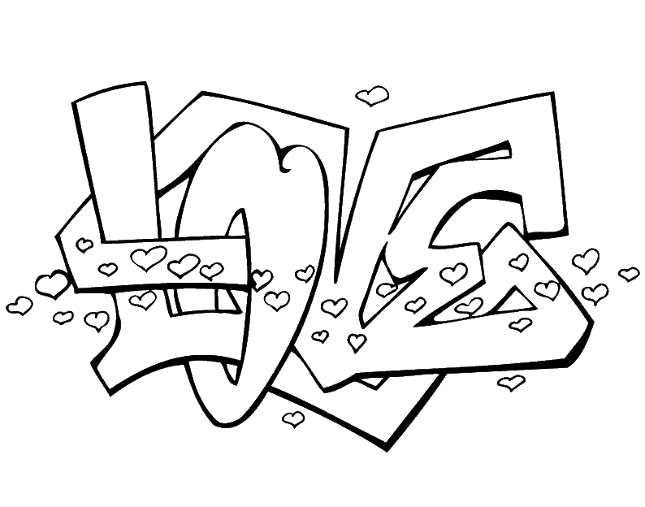
Free Powerpoint Templates

Slide 11
Free Powerpoint Templates

Slide 12
Assignment:
Choose a word and illustrate that word using it’s characteristics.
Brainstorming – thumbnail sketches of words / designs.
Your Finished piece MUST
be full page in size.
be a polished and finished piece,
NOT a rough sketch.
Think!
How can you illustrate your type to give meaning to the word?
What characteristics can be used to show meaning?
Free Powerpoint Templates

