Slide 1
Value and Tone
Sketchbook

Slide 2
WHAT?
Value – simply put – is the darkness or lightness of an object. It pertains to the use of light or dark, shade and highlight in artwork.
Believe it or not, value is more important than color to the design and success of a piece of artwork.

Slide 3
WHERE?
Value is used in all artwork! Black and white photography depends entirely on value to define its subjects.
Many famous successful artists use a narrow value scale in order to help create cohesive and harmonious works of art. Limiting the value scale to about 4 values will affect the mood of your artwork. (examples to come)

Slide 4
WHEN?
Be aware of value when creating artwork.
Value (or tone in color artworks) is an essential skill an artist must be able to use properly. If not used correctly art with weak values tend to look dull and flat.

Slide 5
WHY?
Value is what gives 2D surfaces a 3D feel.
Proper use of value can also give your artwork a feeling of space.
When working on 2D surfaces remember that the closer objects get to the horizon the lighter and less detail the object will have. This is due to atmospheric perspective.

Slide 6
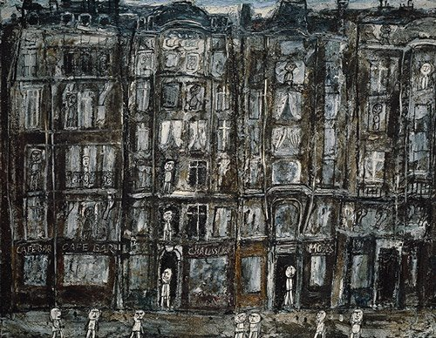
EXAMPLES: “low-key”
Apartment Houses, Paris, 1946
Jean Dubuffet

Slide 7
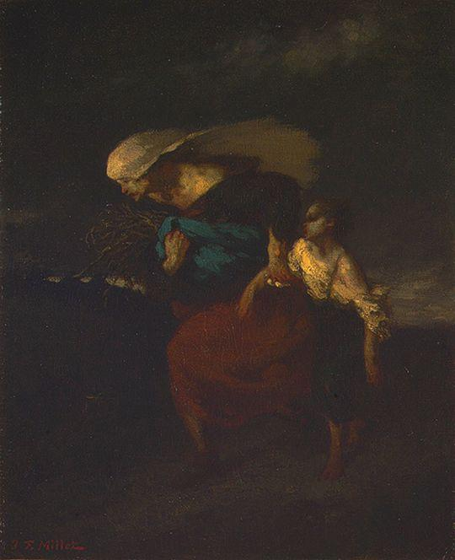
EXAMPLES: “low-key”
Retreat from the Storm, ca 1846
Jean-Francois Millet

Slide 8
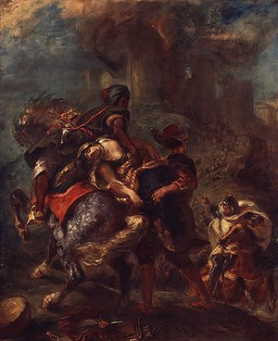
EXAMPLES: “low-key”
The Abduction of Rebecca, 1846
Eugene Delacroix

Slide 9
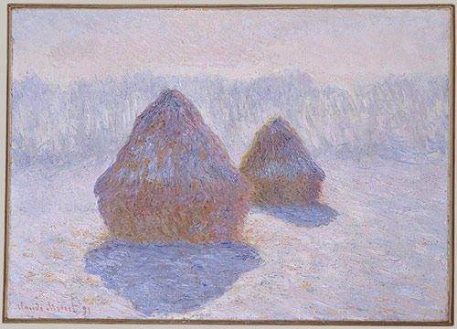
EXAMPLES: “high-key”
Haystacks (Effect of Snow and Sun), 1891
Claude Monet

Slide 10
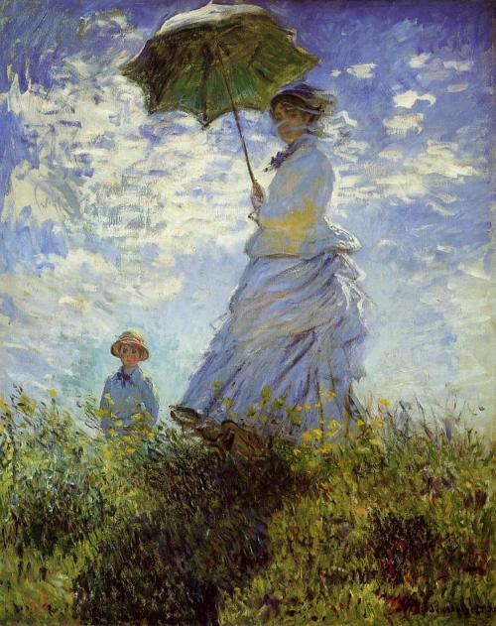
EXAMPLES: “high-key”
La Promenade, La Femme a l’ombrelle, 1875
Claude Monet

Slide 11
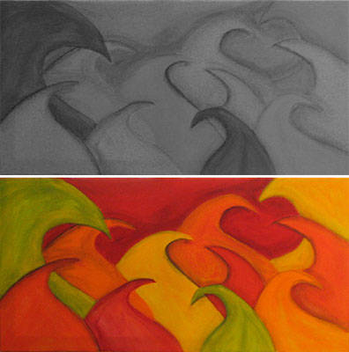
EXAMPLE

Slide 12
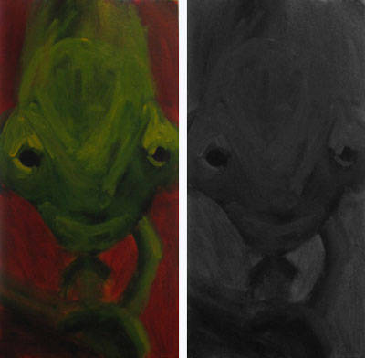
EXAMPLE

Slide 13
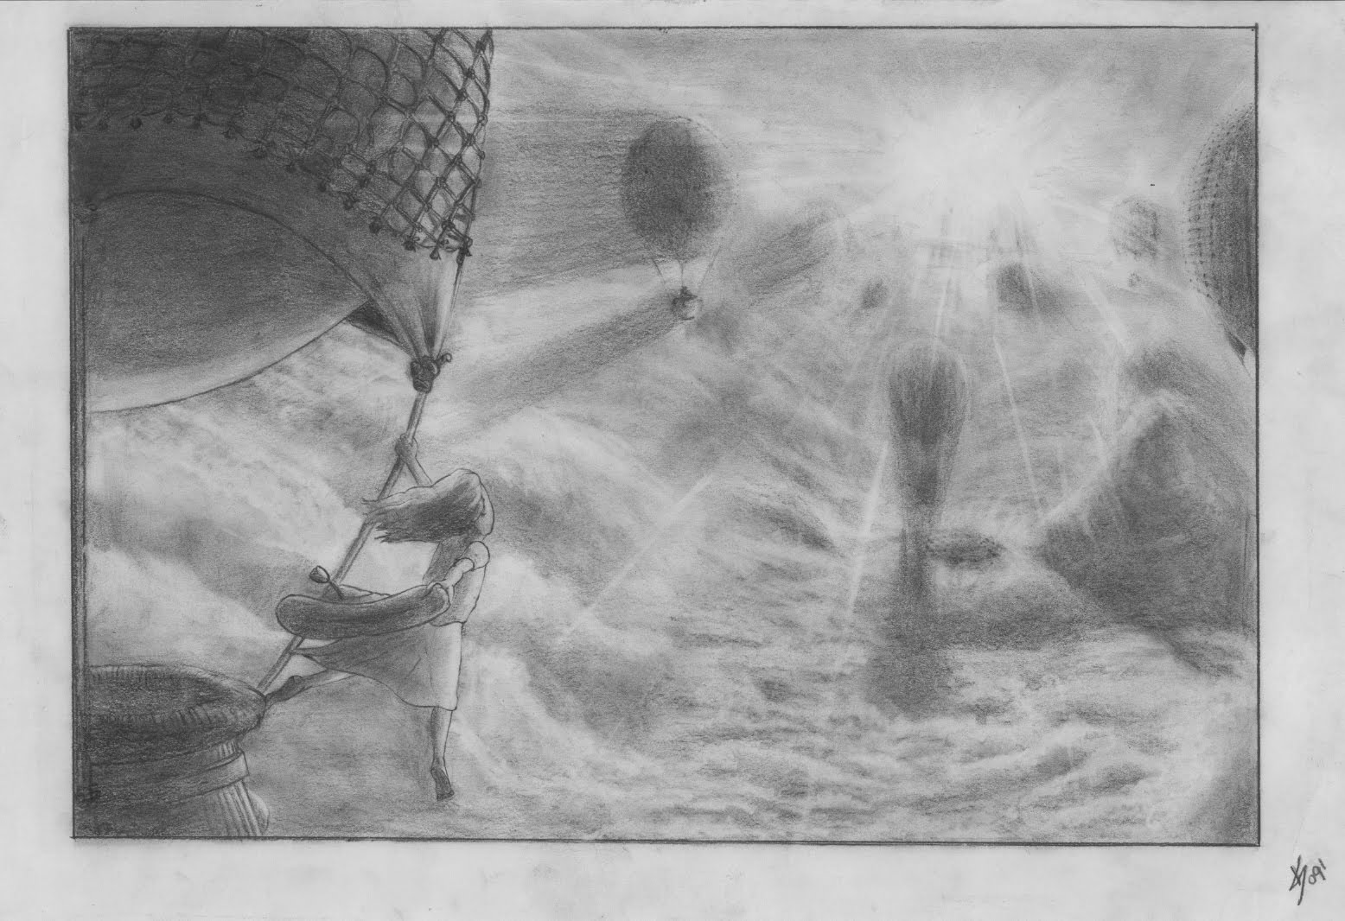
EXAMPLE: atmospheric perspective
Air, 2009
Keith Sizemore

Slide 14
TONE
Tone is the value applied to a color or hue.
Light tones are created by adding white or yellow to a pigment
Dark tones are created by adding black, grey or blue to a pigment.
When creating 2D artwork in color, make sure to have a wide range of tones.

Slide 15
ASSIGNMENT
Grade 10
Create a grayscale value scale in your sketchbook. This value scale must include 8 steps from white to black in graphite. You must use a ruler to create your value scale grid. Draw this value scale at the top of your sketchbook page – leave half of your page for the rest of the assignment.
On the bottom half of your sketchbook page, use one of the black and white images provided to create a value study composition. Use only half of the image chosen. Cut and paste the portion you are using in your sketchbook (be creative). You will draw in grayscale the pieces missing from the image you’ve selected. You must represent appropriate value, using at least 6 of the 8 tones created in your value scale. Your portion of the drawing should take up AT LEAST three quarters of the space between your cut and pasted bits.

Slide 16
ASSIGNMENT
Senior Students
On your tone handout – or in your sketchbook choose a color to make a tone value scale. Compare the tones in your color scale to the grayscale provided on the handout.
Choose a color image from a magazine. Make sure that the image you choose represents a wide range of tonal changes. In your sketchbook cut and paste half of the image you have selected (be creative). Use the remainder of your sketchbook page to come up with a composition that creatively incorporates a wide range of tones.
The composition that you create must contain a wide range of tones as well as take up at least three thirds of the space left over after you’ve pasted your image. Choose your image wisely – make sure there is plenty of tone range.

